Slide 1


CS425 Game Engine Design Project
Peter Shin
Renato Scudere.

Slide 2


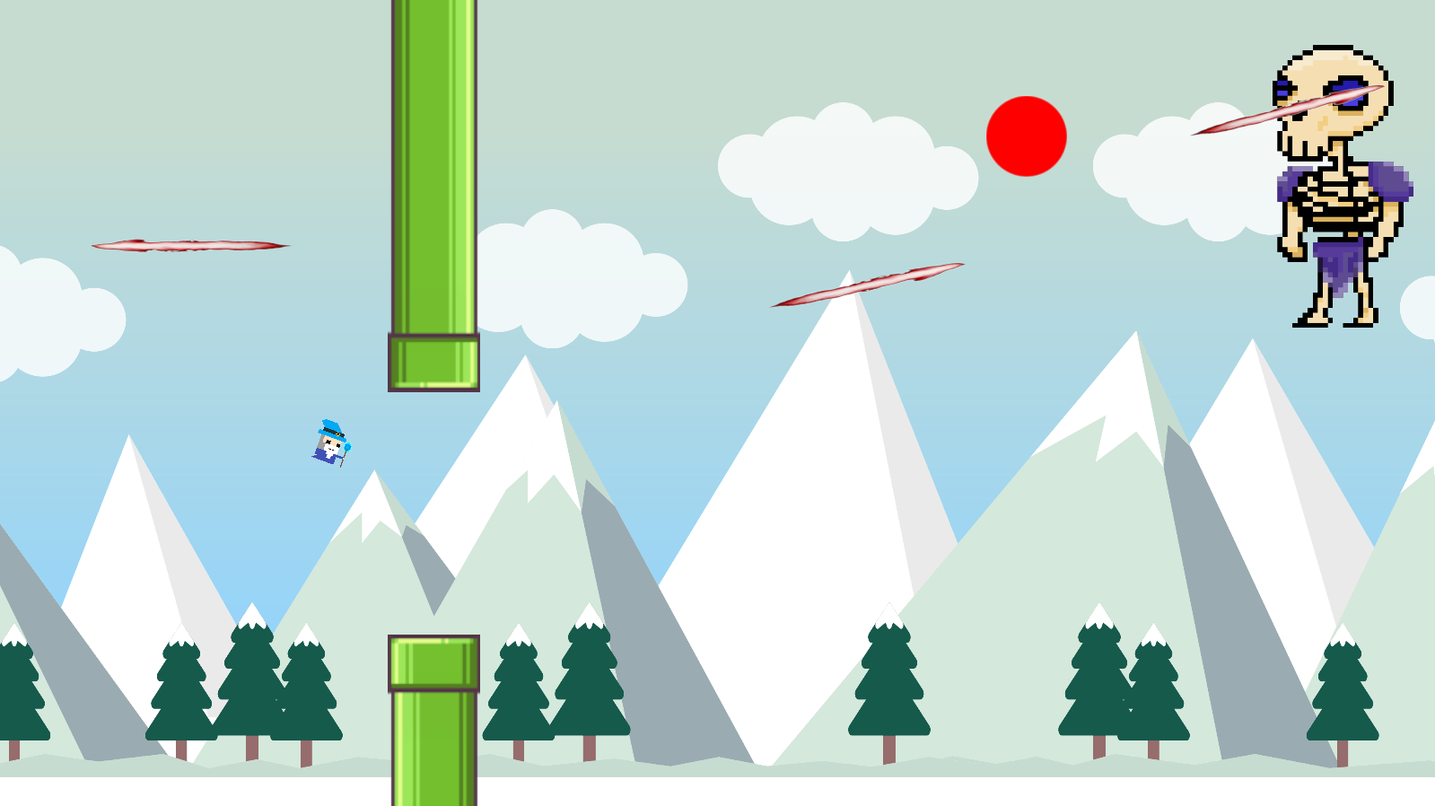
Technology
Rigid Body Dynamics
Physics/motion, Collision detection and resolution.
Enemy AI
State machine, decision trees, auto-aiming.

Slide 3
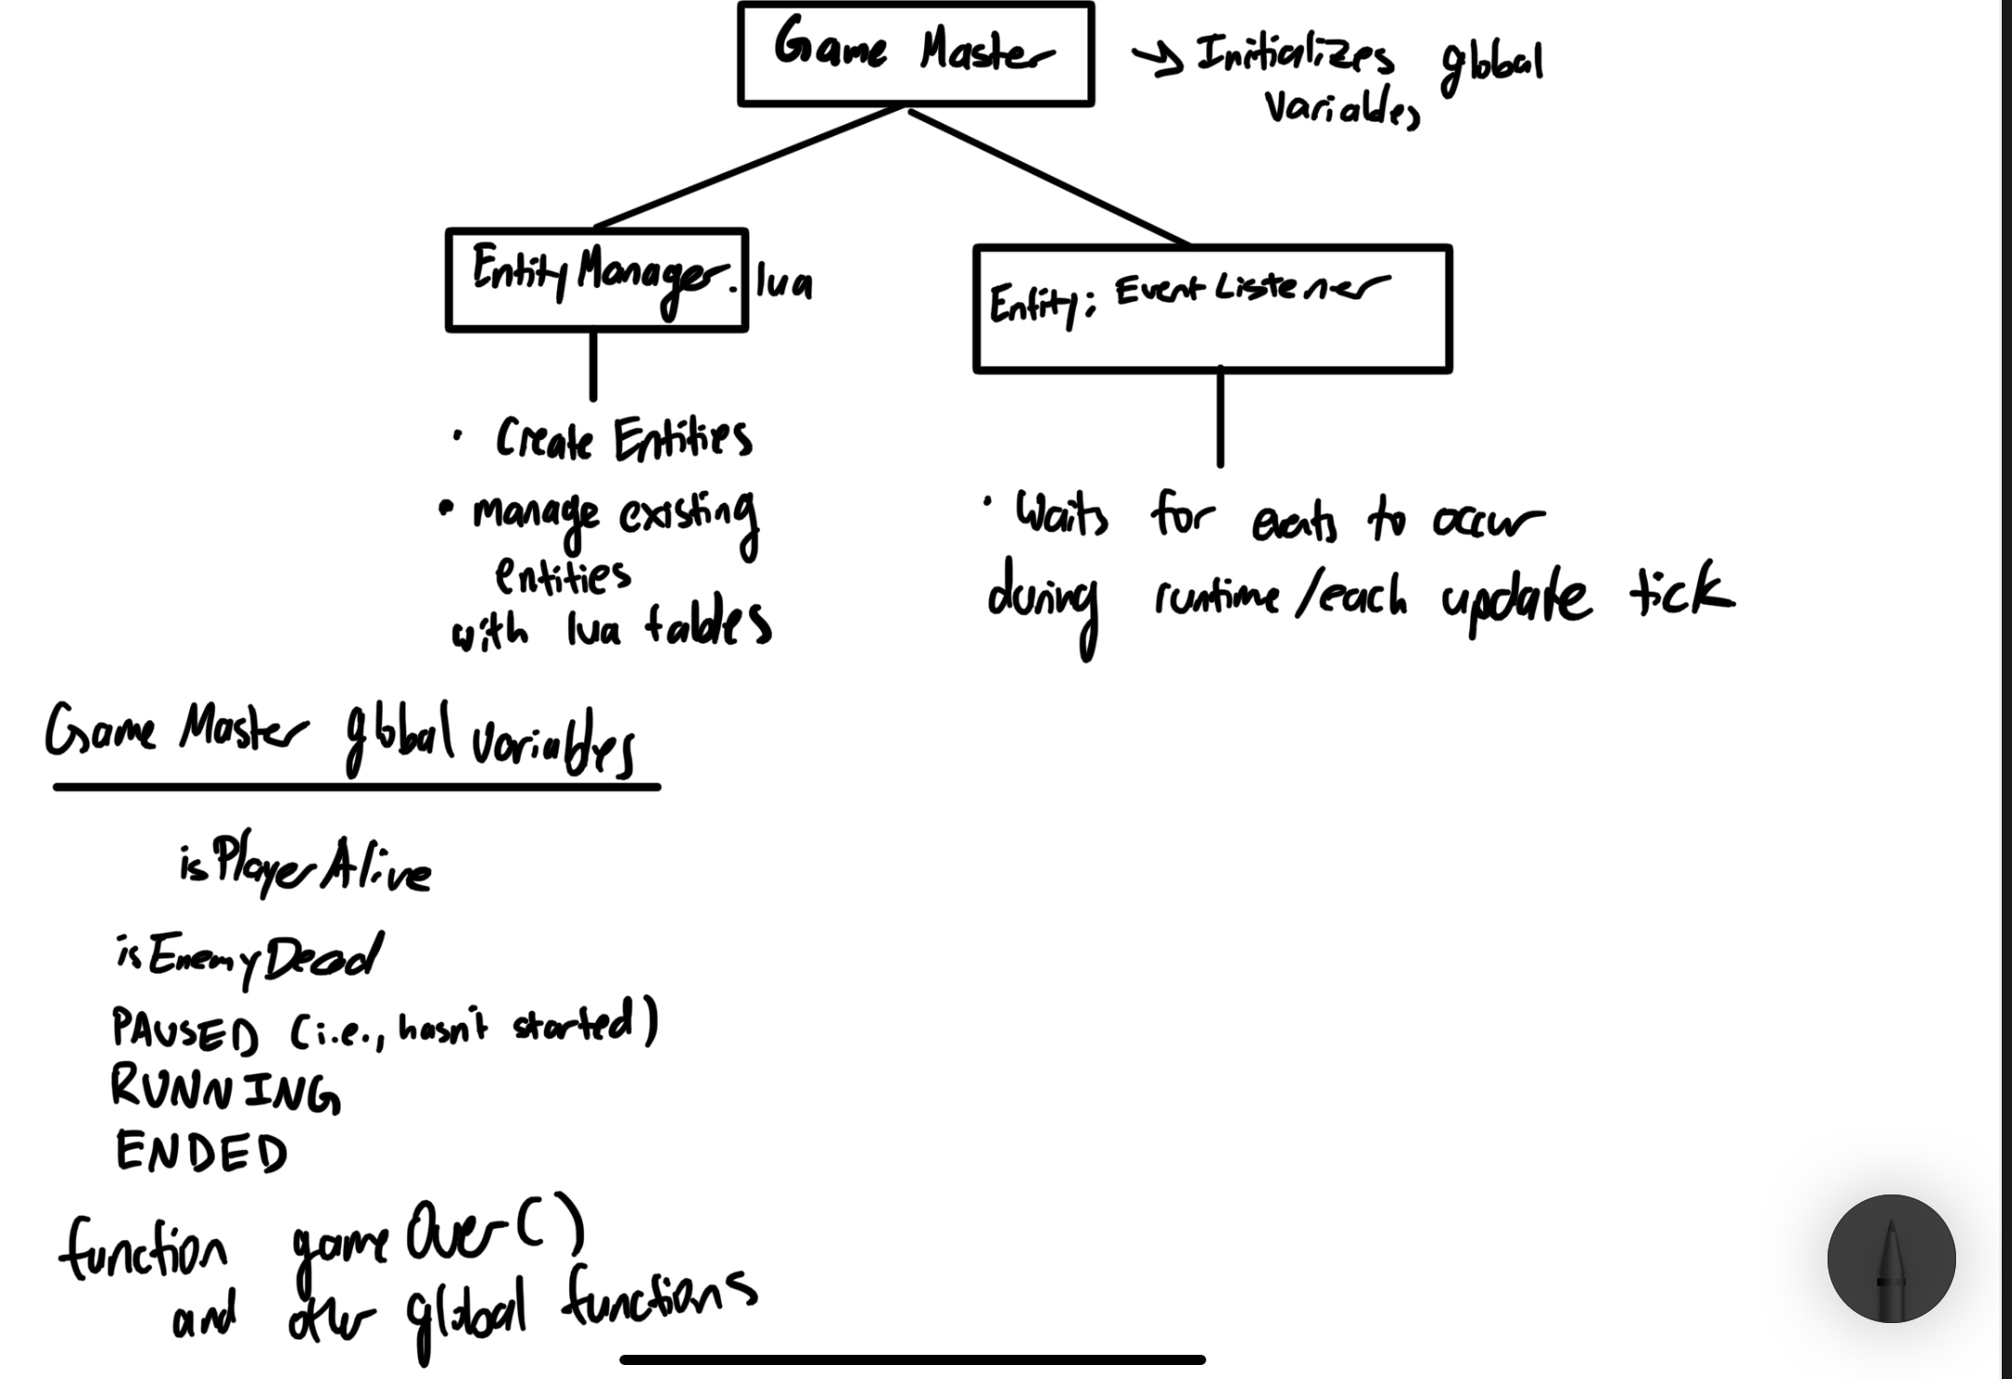
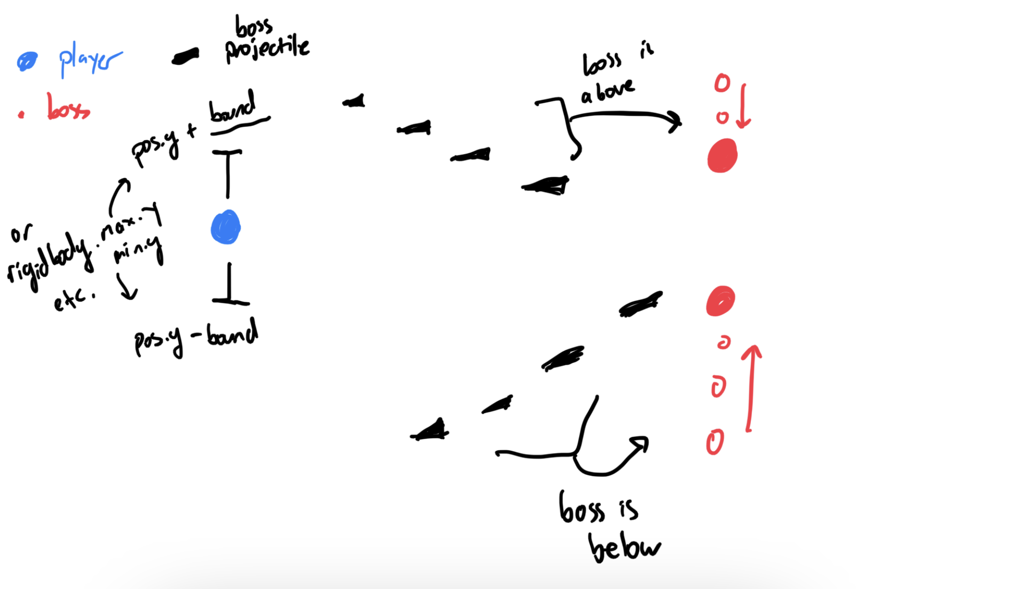

Slide 4
What Went Right/Wrong
Rigid Body Dynamics
Physics simulation and collision detection work well.
Collision response can’t handle all cases.
Inefficient code.
Enemy AI
Works as expected
AI might be a little too mean/difficulty balancing gameplay

